Slide 1
Words Their Way Yellow Book Sort 34
Spelling Sorts: Do not use Slide Show to sort the words.

Slide 2
Yellow Sort 34
wa
al
ou
oddballs
watch
small
thought
walk
salt
wash
bought
calm
chalk
swap
fought
wasp
bald
wand
talk
stalk
though
stall
ought
swat
brought
cough
also
almost

Slide 3
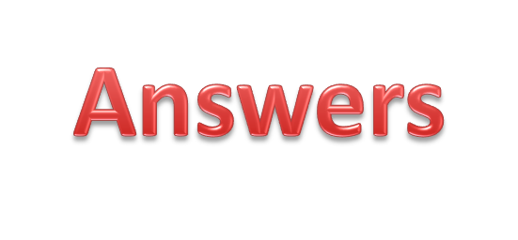
Yellow Sort 34
wa
al
ou
oddballs
watch
small
thought
calm
wash
walk
bought
brought
though
wand
salt
fought
cough
wasp
stalk
ought
swap
talk
swat
bald
chalk
stall
also
almost

